Slide 1
Draw Something
By Ilia Benson

Slide 2
It’s an authoring tool with a twist
Simple authoring tool
Can easily be frontend app only
Easily convertible to MEAN Stack
Has RESTful API
Completely independent
No CORS issues

Slide 3
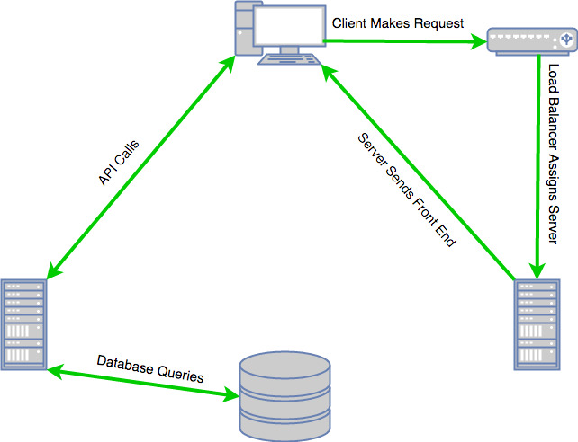
What is CORS

Slide 4
Single Page Application (SPA)
Angular 5 Frontend
Laravel 5.5 Backend
Bootstrap 3 with SASS (installed not used)
MySQL
AWS Ubuntu LAMP Stack
Github

Slide 5

Current setup

Slide 6
Demo
http://ec2-34-216-138-204.us-west-2.compute.amazonaws.com/
https://github.com/iliabenson/comp467
https://github.com/iliabenson/comp467.git
https://www.npmjs.com/package/ng2-canvas-whiteboard

